Slide 1
Public School Ranking System

Slide 2




Kyla Joyce M. Julian
SS152
PROJECT MANAGER
Rhea-Eve M. Ayungon
SS152
DEVELOPER / QUALITY ASSURANCE ANALYST
Kathrine Danielle C. Burton
SS152
DATABASE ANALYST / DOCUMENTATION LEAD
Joneil Thom O. Llantos
SS152
LEAD DEVELOPER

Slide 3






WHAT IS IT ABOUT?
Student’s Performance
Filipino
English
Mathematics
Science
Araling Panlipunan
Notes:
DANE: can help schools be aware and help improve their students’ performance in their major subjects namely: Filipino, English, Mathematics, Science, and Araling Panlipunan through the help of Analytics.

Slide 4
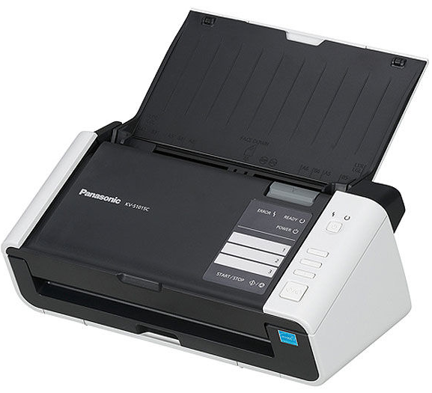
OPTICAL RECOGNITION Mark (omr)
Notes:
KYLA:

Slide 5

OUR CLIENT
Notes:
DANE:

Slide 6





DepEd: Bureau of Educational Assessment
Regional Directors
Division Superintendent
Student
District Administrator
Notes:
The project will be useful for the Bureau of Educational Assessment and will be beneficial to the Regional Directors, Division Superintendents, District Administrator down to the students.

Slide 7

PROBLEM STATEMENT
Aside from the fact that the system is not yet implemented in the country, it is also evident that quality education in public schools is compromised and needs improvement in technology.
Notes:
THOM:

Slide 8

SITUATIONAL ANALYSIS
The problem exists due to the philosophy opposing modern technology. It is hard and requires a huge amount of time to monitor the student’s progress throughout the school year without the intervention of technology because in the present situation, “eyeballing” is practiced in assessing data.
Notes:
KYLA

Slide 9

PROPOSED SOLUTION
Design a software which will be useful to evaluate student performance on OMR sheets.
Build an exam generation system that is powered by Moodle
Build a ranking system on a dashboard that can produce reports.
Notes:
RHEA:
The system will be designed to process, extract and evaluate the scanned answer sheets.
to build and facilitate exams with a variety of questions and answers.
This will help in tracking the school’s down to its student’s performance.

Slide 10

The expected outcome

Slide 11

Improved access and data availability to academic performance.
Improved exam assessment.
Reduced errors in administering un-centralized exams.
Improved accuracy and reliability of exam results.
Reduced time to prepare reports
Notes:
RHEA & THOM

Slide 12

DIAGRAMS

